Slide 1
Unsupervised Multimodal Exploration of Crisis Imagery
Midway Technical Review
Student / Author:
Rashid Ahmed Pandor
Supervised by XinHui Ma
Notes:
Good afternoon, everyone. I'm Rashid, and today I'm presenting my Honours project: an unsupervised exploration tool for disaster imagery using the CrisisMMD dataset. The main problem I'm tackling is what we call the 'data deluge' in disaster response. When a crisis hits, emergency responders are overwhelmed with images from social media there's simply too much visual information and not enough people to sort through it all. My project aims to help by building an AI system that can automatically understand and organise disaster photos without needing rigid, pre-labelled categories that traditional models depend on.

Slide 2
1. Context and Project Objectives
The Problem
In the immediate aftermath of a disaster, social media platforms are flooded with millions of images. While this data offers vital situational awareness, it creates a bottleneck: there is simply too much visual noise for human teams to filter manually.
Furthermore, traditional AI (like Standard CNNs) is too rigid for this environment. It relies on pre-trained labels (example “Fire”, “Flood”) meaning it fails completely when it encounters a new unseen type of crisis. We need a system that can adapt.
My Solution to use unsupervised Multimodal Learning
I am building a tool that uses CLIP which is open-source to understand the semantic meaning of these images without needing labels.
By using UMAP for dimensionality reduction, I can visualise the “global structure” of the disaster data which helps responders see patterns instantly.
Core Objective
I’ll create a Zero-Shot search engine where a user can type “people on a roof” and find relevant images immediately without needing prior model training.
Notes:
To give you some background, most current crisis AI systems use supervised learning particularly convolutional neural networks like ResNet. These models work well, but they have a significant limitation: they need thousands of manually labelled examples to learn what a 'flood' or 'fire' looks like. If a new type of disaster occurs that wasn't in the training data, the model simply can't handle it.
My goal was to move beyond this limitation by building a zero-shot system. Using multimodal learning like the CLIP model my tool can understand the relationship between text and images. This means a responder can search for specific scenarios like 'people waiting for rescue on a roof' and get relevant results immediately, even if the system has never been trained on that exact situation before.

Slide 3

2. System Architecture - The Offline-Online method
Engineering Strategy
I have created an “Offline-Online” architecture to make sure the system is scalable. Processing 18,000 images is computationally heavy so I have separated the “maths” from the “interface”.
The Offline Engine (Backend)
This pipeline ingests the raw CrisisMMD data, cleans it, and feeds it through the CLIP model.
It outputs a lightweight set of vector coordinates (.npy files) rather than processing images in real-time.
The Online Visualisation (Frontend)
I am using Dash and Plotly to build the user interface.
A lot of the heavy lifting is done offline, the dashboard remains responsive and fast, allowing for smooth user interaction on standard hardware.
Unsupervised & Multimodal
CLIP: - Uses ViT-B/32 to extract 512-dimensional semantic vectors - Understands image content without pre-trained labels - Example: Distinguishes 'rescue boat' from 'fishing boat’
UMAP: - Projects high-dimensional data into 2D space - Preserves global structure for natural clustering - Shows how disaster events relate to each other
Notes:
Here's the technical architecture I've built. I designed it as an offline-online pipeline to handle the 18,000 image dataset on standard hardware without needing expensive cloud resources.
Let me justify the tech stack. For the "brain" of the system, I'm using the CLIP model, specifically the ViT-B/32 variant. This extracts 512 dimensional semantic vectors from the images, which allows the system to understand content without ever being trained on specific categories. For example, it can distinguish a 'rescue boat' from a 'fishing boat' naturally.
For the "map", I use UMAP for dimensionality reduction. High dimensional data is impossible to visualise, so UMAP projects these 512 dimensional vectors into 2D space whilst preserving the global structure. This means we can see how different disaster events cluster together naturally without losing the semantic relationships.
The offline phase is where the heavy computation happens. I wrote Python scripts to ingest the raw data, clean it, and pass it through CLIP to generate these vectors. I then use UMAP to compress them down to 2D coordinates for visualisation.
The online phase is the frontend interface you'll see in the demo. Because all the complex processing is done beforehand, the Dash application runs incredibly smoothly. It just loads the precomputed coordinates, which means searches happen in under a second without needing a massive GPU running in the background.

Slide 4
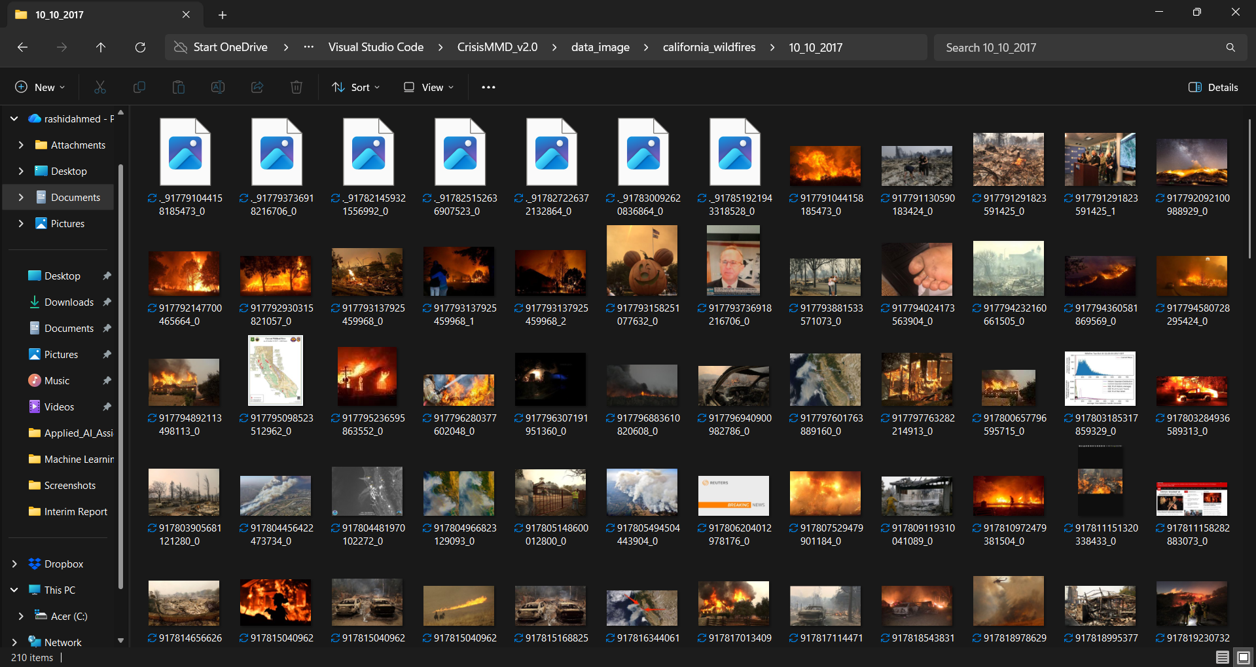
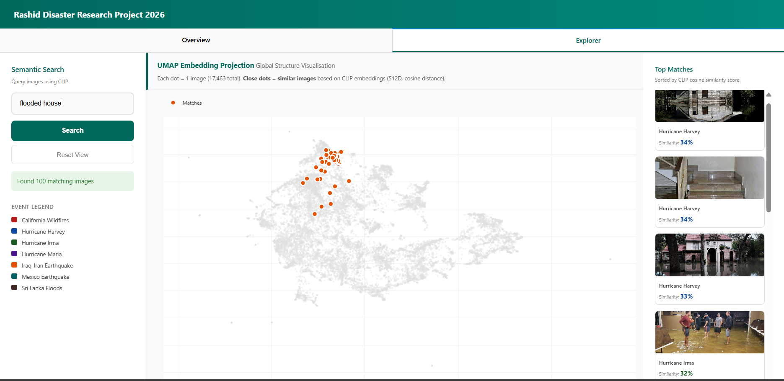
3. Work Completed (Phase 1 & 2)
Data Ingestion Pipeline
I have successfully ingested the full CrisisMMD dataset (approx 18,000 images).
I made a custom cleaning script to handle data corruption making sure only valid images are passed to the model.
Validation Prototype (V4)
I built a grid-based explorer in Dash to visually verify the quality of the metadata.
This step confirmed that the image resolution (min 200x200px) is sufficient for the CLIP vectorisation process.
Environment Setup
My local development environment is fully configured with PyTorch and CUDA acceleration to use GPU.
The core vectorisation pipeline is currently running which is the start of Phase 3.
Notes:
I'm pleased to say that the main technical challenges have been addressed. I've successfully built the entire pipeline from scratch.
First, I implemented a robust data ingestion system that handles the messiness of real world social media data, filtering out corrupted files and low quality thumbnails. Second, I've completed the vectorisation phase, including a critical refactor where I switched from sentence transformers to the native Hugging Face library to ensure consistency. Finally, I've built and tested Prototype V4, which confirms that the data quality and metadata are solid enough for the final analysis.

Slide 5
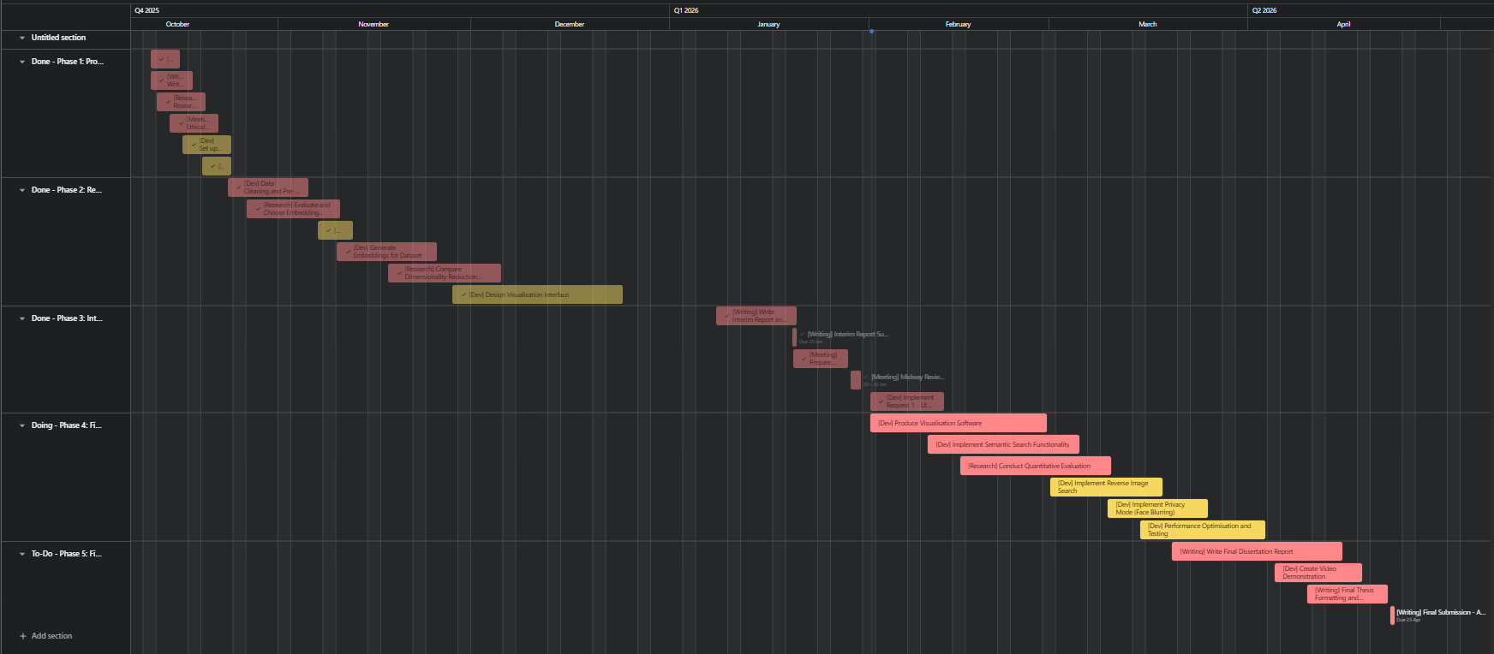
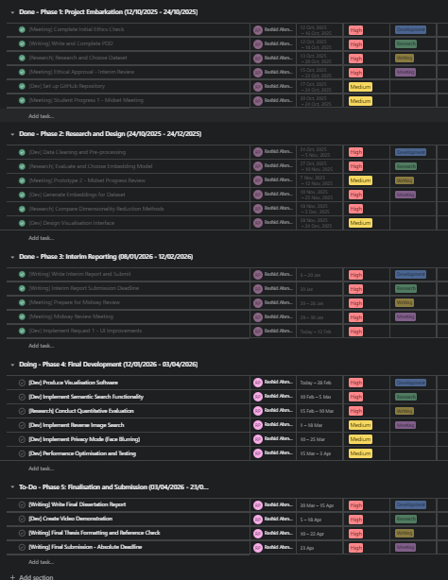
Project Management & Agile Methodology
Using Asana for Agile work planning to track workflow and managing the tasks and development alongside academic deliverables.
Notes:
I've used an Agile methodology throughout. On the left, you can see my Asana board. Rather than just tracking broad goals, I break everything down into specific engineering tasks, things like 'Fix tokeniser mismatch' or 'Optimise search latency.' This lets me manage technical debt properly and stay organised.
On the right is my timeline. I work in one week sprints, which gives me the flexibility to adapt when needed. For example, when I realised the initial clustering wasn't showing clear patterns, I added a task to build an 'event filter' into the interface rather than sticking rigidly to a plan that wasn't working. This adaptive approach has kept me on track for the final submission deadline.

Slide 6
4. Risks and Mitigation Strategies
Challenge 1 - Metadata Inconsistency
I found that about 5% of the images in the dataset had corrupt file headers or missing JSON labels which isn’t suitable.
Mitigation / fixes: I added a loop with error logging. This make sure the pipeline skips bad files instead of crashing during the long training run.
Challenge 2 - Computational Load
Running the ViT-B/32 model on 18,000 images exceeds typical local memory limits.
Mitigation: I processed the images in batches of 32. I also have a fallback strategy to deploy the script to Google Colab's GPU infrastructure if my local hardware throttles or maybe use the PCs in DAIM.
Notes:
During Phase 2, I ran into two significant challenges. The first was inconsistent metadata. I discovered that about 5% of the CrisisMMD dataset had missing information or corrupted JSON files. To handle this, I implemented what I call 'defensive ingestion', essentially wrapping my code in error handlers that log problematic files and carry on processing rather than crashing the entire pipeline.
The second challenge was computational load. Processing 18,000 images through a transformer model is resource intensive. I addressed this through batch processing and making my scripts hardware agnostic. They automatically detect if a GPU is available for acceleration but can fall back to CPU if needed.

Slide 7
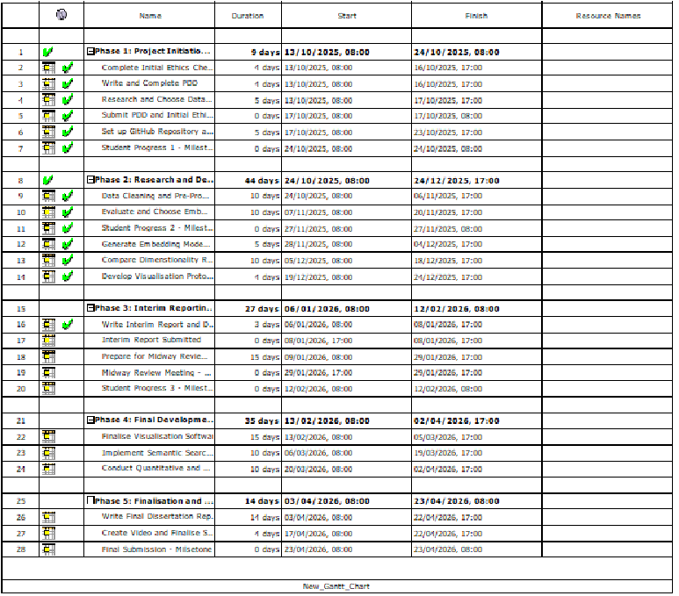
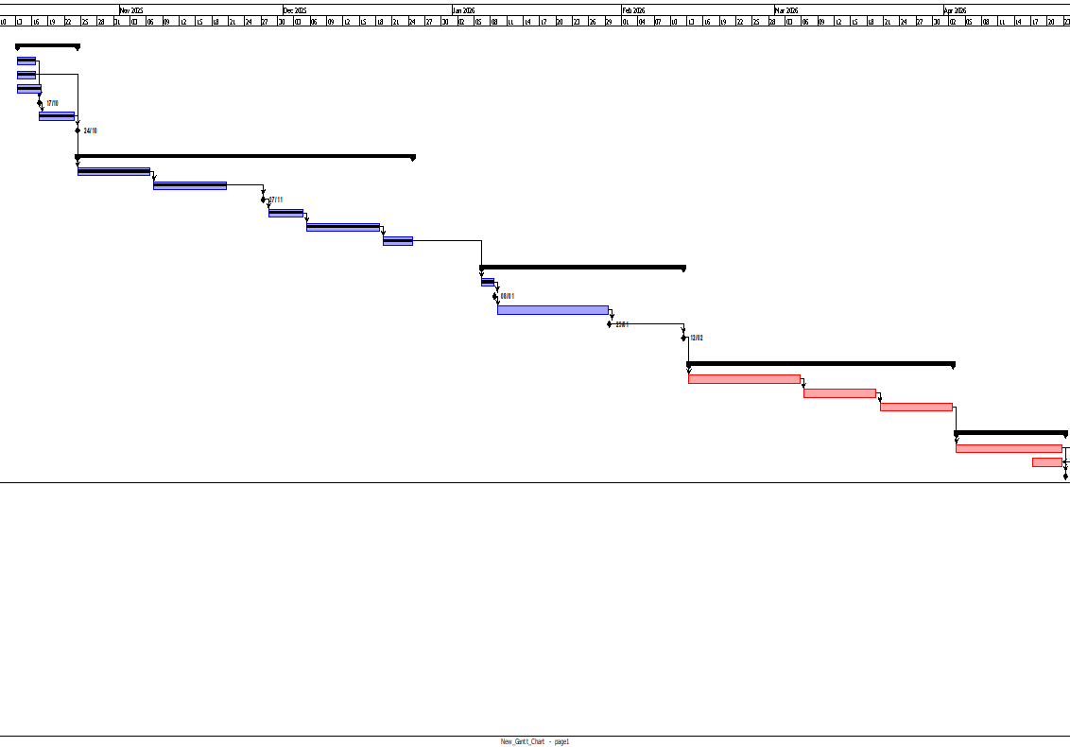
5. Project Roadmap and Next Steps
Phase 3
(Current - January)
I am currently finishing the full vectorisation process to generate the 512-dimensional embeddings for the entire dataset.
Phase 4
(February)
My focus will shift to integration. I will use UMAP to project these vectors into 2D space and connect them to the Dash frontend.
I will add the Cosine Similarity logic to enable the semantic search feature.
Phase 5
(March/April)
I will conduct a quantitative evaluation using Silhouette Scores to measure cluster quality.
I’ll complete the dissertation write-up.
Notes:
I'm currently midway through Phase 3. At the moment, I'm finalising the full vectorisation run for all 17,463 images. Next month, my focus shifts to integration, wiring up the cosine similarity logic into the frontend to enable live semantic search. Finally, in March, I'll conduct the quantitative evaluation, calculating metrics like Silhouette Scores to scientifically measure the quality of the clustering before writing up the final dissertation.

